Slide 1
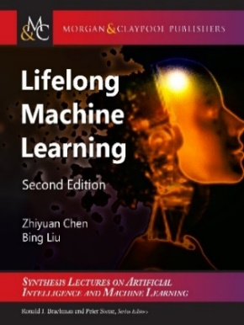

Lifelong and Continual Learning
Bing Liu
University of Illinois at Chicago & Peking University

Slide 2
Introduction
Learning is key to all human (and AI agent) activities
Classic machine learning
Isolated single-task learning
Knowledge learned not accumulated or used in new learning
Needs a large number of training examples:
cannot expect humans to label everything in the world.
Suitable for well-defined tasks in restricted and narrow environments

Slide 3
An example
Have you ever been given 1000 positive and 1000 negative online reviews and asked
to build a classifier to classify Camera reviews
Never happened to me. I don’t need any training data now.
I have accumulated so much knowledge in the past
about how people praise/criticize things and experiences …
If I don’t have the accumulated knowledge, NO
E.g., I don’t know Arabic and if someone gives me 2000 training reviews in Arabic, I cannot do it.

Slide 4
Lifelong learning (Chen and Liu, 2016, 2018 book)
Humans never learn in isolation or from scratch. We
learn continuously and incrementally,
accumulate knowledge learned in the past, and
use/adapt the knowledge to learn more & to learn better.
Mostly in a self-supervised (unsupervised) manner
Lifelong Learning (LL): imitate this human learning capability
Goal: Create a machine that learns like humans
Necessary for Artificial General Intelligence
Notes:
No memory: 1. Knowledge is not cumulative. 2. Cannot learn by leveraging past learned knowledge
Probably not possible to build an intelligent agent using only ML 1.0 algorithms

Slide 5
Practical applications need LL
Chatbots, personal assistants, physical robots, working in dynamic/open environments need LL.
Personal assistants will not be intelligent if they cannot learn more knowledge after they are deployed
Self-driving cars are not going to fly with only rules and off-line training
Unmanned vehicles will not work in an unfamiliar terrain
They have to continuously learn and accumulate knowledge and adapt to new situations in a self-supervised manner.

Slide 6
Outline
A motivating example in sentiment analysis
What is lifelong learning?
Lifelong supervised learning
Semi-supervised never-ending learning
Lifelong topic modeling
Lifelong information extraction
Continual learning and catastrophic forgetting
knowledge learning in dialogues: Learning on the job
Open-world learning
Summary

Slide 7
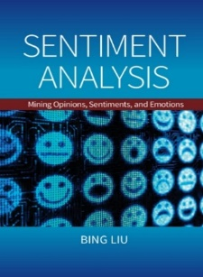
Sentiment Analysis (SA) problem (Hu and Liu 2004; Liu 2006, 2012)
Id: John on 5-1-2008 -- “I bought an iPhone yesterday. It is such a nice phone. The touch screen is really cool. The voice quality is great too. It is much better than my old Blackberry. …”
Definition: An opinion is a quadruple,
(target, sentiment, holder, time)
A more practical definition:
(entity, aspect, sentiment, holder, time)
E.g., (iPhone, touch_screen, +, John, 5-1-2008)
SA goal: Given an opinion doc, mine all quintuples

Slide 8
Opinion summary (Hu and Liu, 2004) (Liu et al. 2005)
Opinion Summary of 1 phone
Aspect/feature based summary of opinions about a phone:
Aspect: Touch screen
Positive: 212
The touch screen was really cool.
The touch screen was so easy to use and can do amazing things.
…
Negative: 6
The screen is easily scratched.
I have a lot of difficulty in removing finger marks from the touch screen.
…
Aspect: voice quality
…
+
_
Voice Screen Battery size weight
Opinion comparison of 2 phones
+
_

Slide 9
Scale-up challenges
Not so hard to build a SA system for applications involving one or two domains (e.g., product categories).
Major challenge in the real world: scale up to
thousands of categories (e.g., BestBuy), and
tens of thousands of categories (e.g., Amazon.com).
Problems:
Low accuracy 60-70% for sentence-level sentiment classification
Aspect-level sentiment classification is worse.
Aspect extraction is a headache

Slide 10
Observation: knowledge shared across domains
Experience in 2 startups: After working on numerous SA projects for clients, I realized
a lot of sharing of concepts across domains (product categories)
Easy to see this about sentiment words,
e.g., good, bad, poor, terrible, etc.
Aspect grouping is shared too
picture = photo and expensive = price
A great deal of product features/aspect sharing too …

Slide 11
Scale-up sentiment analysis (SA)!
A great deal of product features (or aspects) sharing across domains, e.g.,
Every product review domain has the aspect price
Most electronic products share the aspect battery
Many also share the aspect of screen.
….
As we see more and more, fewer and fewer things are new.
How to scale up SA to 1400 (BestBuy) or more product categories
Leveraging the sharing
Notes:
In the slides later, we’ll show the work that exploit such sharing as the knowledge to significantly enhance the performance.

Slide 12
My motivation to work on LL
How to systematically leverage such sharing?
Retain/accumulate knowledge learned in the past.
use the knowledge to help new task learning
I.e.: lifelong learning
Do better and better with more and more domains!
This leads to our LL work (not just in SA)
Lifelong topic modeling and aspect extraction (Chen and Liu 2014a, b)
Lifelong sentiment classification (Chen et al. 2015)
others in 2016, 2017, 2018, 2019

Slide 13
Outline
A motivating example in sentiment analysis
What is lifelong learning?
Lifelong supervised learning
Semi-supervised never-ending learning
Lifelong topic modeling
Lifelong information extraction
Continual learning and catastrophic forgetting
knowledge learning in dialogues: Learning on the job
Open-world learning
Summary

Slide 14
Old definition of lifelong learning (LL) (Thrun 1995, Silver et al 2013; Chen and Liu, 2016)
The learner has performed learning on a sequence of tasks, from 1 to N.
When faced with the (N+1)th task, it uses the relevant knowledge in its knowledge base (KB) to help learn the (N+1)th task.
After learning (N+1)th task, KB is updated with the learned results from (N+1)th task.

Slide 15
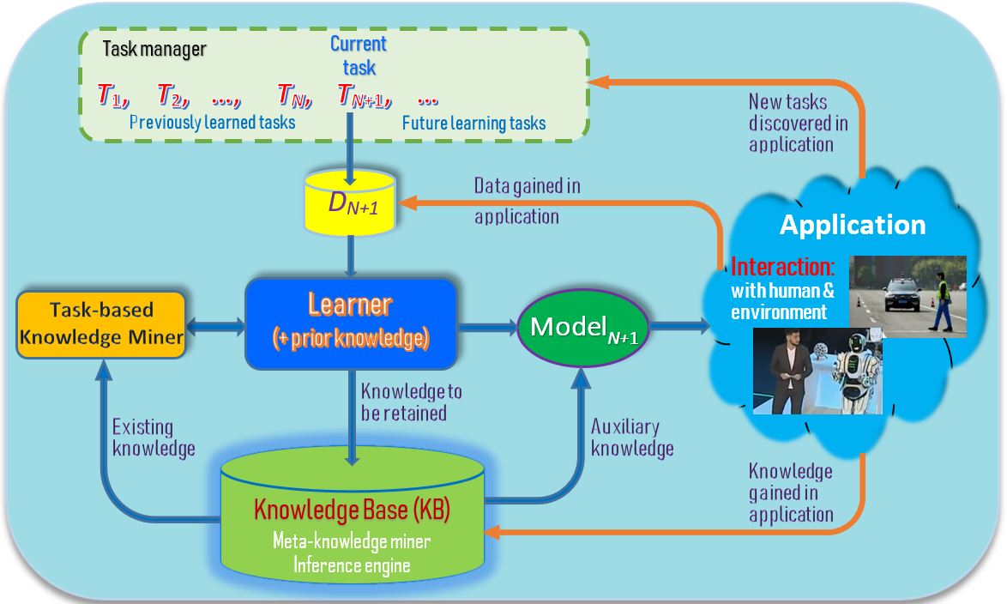
Extended definition of lifelong learning (Fei et al 2016, Shu et al 2017a, 2017, Chen & Liu, 2018, Mazumder, Liu, et al, 2019)
LL also works with a sequence of subtasks in a task, e.g., in dialogues.

Slide 16
Key characteristics of LL (Chen and Liu, 2018-book)
Continuous learning process (w/o supervision)
Knowledge accumulation in KB (long-term memory)
Using/adapting past knowledge to help future learning
Open-world learning: discovering new or unseen tasks & learning them incrementally. No closed-world assumption.
Learning on the job (or while working) during model application. Self-supervision based on its prior knowledge and interaction with human users or other AI agents and with the real-world physical environment.
Without catastrophic forgetting: In learning knowledge from new tasks, it should not forget what it has learned from previous tasks.
Notes:
These three characteristics make LML different from related learning tasks such as transfer learning, multi-task learning, online learning and so on.

Slide 17
Two Types of Shared Knowledge
Global knowledge: These methods assume a global latent structure among tasks that are shared (Bou Ammar et al., 2014, Ruvolo and Eaton, 2013b, Thrun, 1996b, Wilson et al., 2007)
Global structure: learned and leveraged in the new task learning.
These methods grew out of multi-task learning.
Local knowledge: do not assume a global latent structure among tasks (Chen and Liu, 2014a,b, Fei et al., 2016, Liu et al., 2016, Shu et al., 2016, 2017).
During the new task learning, they select or meta-mine those pieces of prior knowledge to use based on need.

Slide 18
LL research is ramping up
Many related topics and similar/confusing names
Lifelong learning
Continual learning
Never-ending learning
Open-world learning
Meta-learning
Developmental learning (in robotics)
DARPA program (2018): Lifelong learning machines (L2M)
DARPA program (2019): Open-world AI/learning (SAIL-ON)

Slide 19
Lifelong learning or continual learning
Traditionally, lifelong learning focuses on using the knowledge gained in the past to improve the new task learning.
One can use any learning method.
Continual learning focuses on dealing with catastrophic forgetting in neural networks (NN).
Catastrophic forgetting: in learning a new task, the knowledge learned from previous tasks in the NN may be forgotten.
But both names are used interchangeably more and more.

Slide 20
Transfer, Multitask → Lifelong
Transfer learning: using source domain to help target domain,
Learning is not continuous
No accumulation of knowledge except data
Only one directional: help target domain
Multitask learning: Jointly optimize multiple similar tasks
No accumulation of knowledge except data
Hard to re-learn all when tasks are numerous
No discovery of new problems or no continual learning

Slide 21
Outline
A motivating example in sentiment analysis
What is lifelong learning?
Lifelong supervised learning
Semi-supervised never-ending learning
Lifelong topic modeling
Lifelong information extraction
Continual learning and catastrophic forgetting
knowledge learning in dialogues: Learning on the job
Open-world learning
Summary

Slide 22
Early Work on Lifelong Learning (Thrun, 1996b)
Concept learning tasks: The functions are learned over the lifetime of the learner, f₁, f₂, f₃, … ∈ F.
Each task: learn the function f: I → {0, 1}. f(x)=1 means x is a particular concept.
For example, f_{dog}(x)=1 means x is a dog.
For nth task, we have its training data X
Also the training data X_{k} of k =1 , 2, …, n-1 tasks.
Notes:
Note that we sometimes use N+1 to denote the new coming task, we sometimes use N to denote it. It depends on the particular paper. We follow the notations in each paper.

Slide 23
Intuition
The paper proposed a few approaches based on two learning algorithms,
Memory-based, e.g., kNN or shepard’s method
Neural networks
Intuition: when we learn f_{dog}(x), we can use functions or knowledge learned from previous tasks, such as f_{cat}(x), f_{bird}(x), f_{tree}(x), etc.
Data for f_{cat}(X), f_{bird}(X), f_{tree}(X)… are support sets.

Slide 24
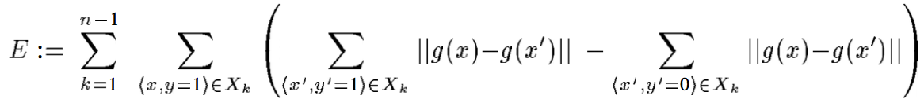
Memory based Lifelong Learning
First method: use the support sets to learn a new representation, or function
g: I → I’
which maps input vectors to a new space. The new space is the input space for the final kNN
Adjust g to minimize the energy function
g is a neural network, trained with Back-Prop. kNN is then applied for the nth (new) task
Notes:
Support sets mean the previous learning tasks.

Slide 25
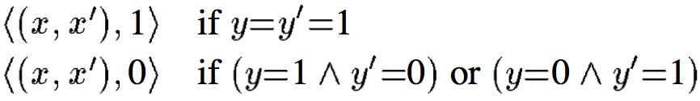
Second Method
It learns a distance function using support sets
d: I × I → [0, 1]
It takes two input vectors x and x’ from a pair of examples <x, y>, <x’, y’> of the same support set X_{k} (k = 1, 2, , …, n-1)
d is trained with neural network using back-prop, and used as a general distance function
Training examples are:

Slide 26
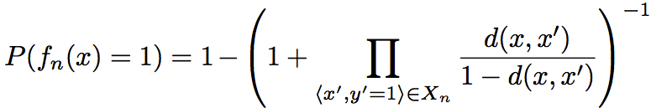
Making Decision
Given the new task training set X_{n} and a test vector x, for each +ve example, (x’, y’=1)∈X_{n},
d(x, x’) is the probability that x is a member of the target concept.
Decision is made by using votes from positive examples, <x₁, 1>, <x₂, 1>, … ∈X_{n} combined with Bayes’ rule

Slide 27
Neural Network approaches
Approach 1: based on that in (Caruana, 1993, 1997), which is actually a batch multitask learning approach.
Simultaneously minimize the error on both the support sets {X_{k}} and the training set X_{n}
Approach 2: an explanation-based neural network (EBNN)
Notes:
They also proposed neural network approaches.

Slide 28
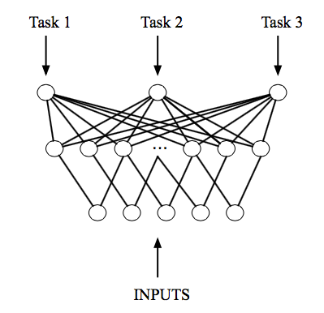
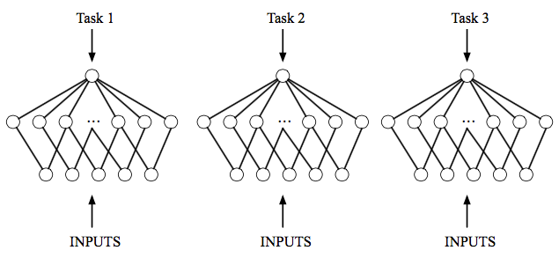
Neural Network approaches

Slide 29
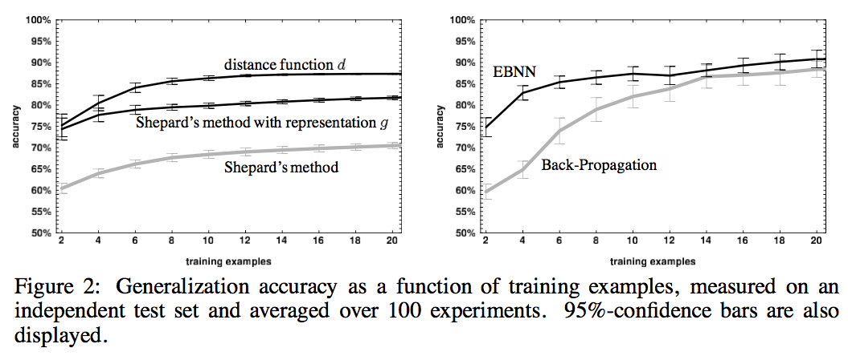
Results

Slide 30
Task Clustering (TC) (Thrun and O’Sullivan, 1996)
In general, not all previous N-1 tasks are similar to the Nth (new) task
Based on a similar idea to the lifelong memory-based methods in (Thrun, 1996b)
It clusters previous tasks into groups or clusters
When the (new) Nth task arrives, it first
selects the most similar cluster and then
uses the distance function of the cluster for classification in the Nth task

Slide 31
Some Other Early works on LL
Constructive inductive learning to deal with learning problem when the original representation space is inadequate for the problem at hand (Michalski, 1993)
Incremental learning primed on a small, incomplete set of primitive concepts (Solomonoff, 1989)
Explanation-based neural networks MTL (Thrun, 1996a)
MTL method of functional (parallel) transfer (Silver & Mercer, 1996)
Lifelong reinforcement learning (Tanaka & Yamamura, 1997)
Collaborative interface agents (Metral & Maes, 1998)

Slide 32
ELLA (Ruvolo & Eaton, 2013a)
ELLA: Efficient Lifelong Learning Algorithm
It is based on GO-MTL (Kumar et al., 2012)
A batch multitask learning method
ELLA is online multitask learning method
ELLA is more efficient and can handle a large number of tasks
Becomes a lifelong learning method
The model for a new task can be added efficiently.
The model for each past task can be updated rapidly.

Slide 33
A Multi-Task Model: GO-MTL (Kumar et al., ICML 2012)
GO-MTL: Grouping and Overlap in Multi-Task Learning
Does not assume that all tasks are related
Applicable to classification and regression
Assumption:
All task models share latent basic model components
Each task model is a linear combination of shared latent components
The linear weight is sparse, with a small number of latent components

Slide 34
Notations
N tasks in total
k (< N) latent basis model components
Each basis component is represented by l (a vector of size d)
For all latent components, L = (l_{1,} l_{2,} …, l_{k})
L is learned from N individual tasks.
E.g., weights/parameters of logistic regression or linear regression

Slide 35
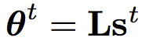
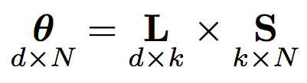
The Approach
s^{t} is a linear weight vector and is assumed to be sparse.
Stacking s^{t} for all tasks, we get S. S captures the task grouping structure.
Notes:
\theta^t is the parameter vector for task t. s^t is the linear weight vector for task t. L denotes the latent basic model components.
Kinda like matrix dcomposition

Slide 36
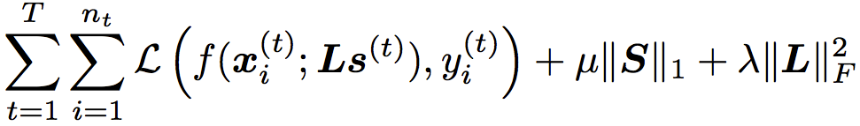
Inefficiency of GO-MTL
Since GO-MTL is a batch multitask learning method, the optimization goes through all tasks and their training instances (Kumar et al., 2012).
Very inefficient and impractical for a large number of tasks.
It cannot incrementally add a new task efficiently

Slide 37
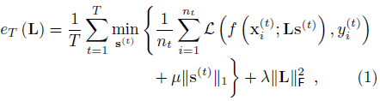
Initial Objective Function of ELLA
Objective Function (Average rather than sum)
Notes:
The biggest inefficiency here is the inner summation over all instances over the past tasks.

Slide 38
Approximate Equation (1)
Eliminate the dependence on all of the past training data through inner summation
By using the 2nd-order Taylor expansion of around θ = θ ^{t} (= θ ^{(t)}): θ ^{t} is an optimal predictor learned on only the training data of task t.
Let
Objective becomes

Slide 39
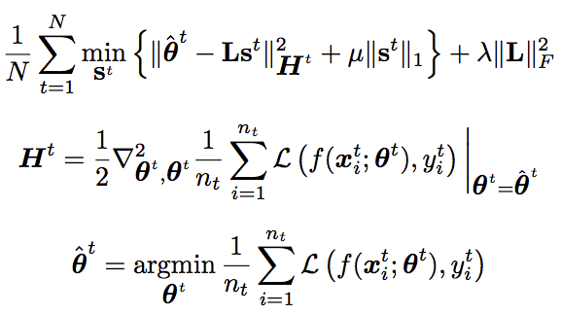
Removing inner summation (applying the 2nd order Taylor expansion)
Objective:
Notes:
H(a) is called Hessian Matrix of function g

Slide 40
Simplify optimization
GO-MTL: when computing a single candidate L, an optimization problem must be solved to re-compute the value of each s ^{(t)}.
ELLA: after s ^{(t)} is computed given the training data for task t, it will not be updated when training on other tasks. Only L will be changed.
Note: (Ruvolo and Eaton, 2013b) added the mechanism to actively select the next task to learn.

Slide 41
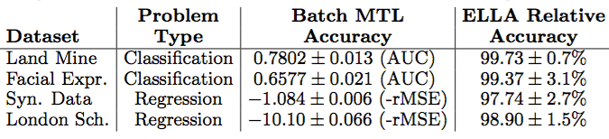
ELLA Accuracy Result
ELLA vs. GO-MTL
Batch MTL is GO-MTL

Slide 42
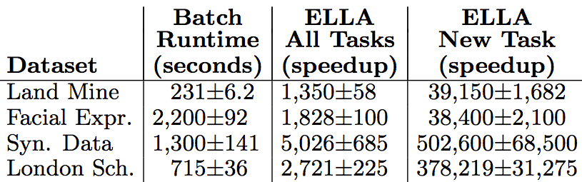
ELLA Speed Result
ELLA vs. GO-MTL
ELLA is 1K times faster than GO-MTL on all tasks, 30K times on a new task

Slide 43
Lifelong sentiment classification (Chen, Ma, and Liu 2015)
“I bought a cellphone a few days ago. It is such a nice phone. The touch screen is really cool. The voice quality is great too. ....”
Goal: classify docs or sentences as + or -.
Need to manually label a lot of training data for each domain, which is highly labor-intensive
Can we not label for every domain or at least not label so many docs/sentences?

Slide 44
A simple LL approach
Assuming we have worked on a large number of past domains with all their training data D
Build a classifier using D, test on the new domain
In many cases – improve accuracy by as much as 19% (= 80%-61%). Why?
In some others cases – not so good, e.g., it works poorly for toy reviews. Why? “toy”

Slide 45
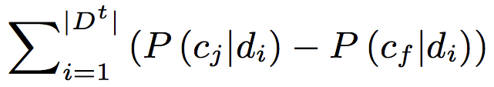
Objective function
Maximize the probability difference
c_{j}: labeled class in ground truth
c_{f}: all classes other than c_{j}

Slide 46
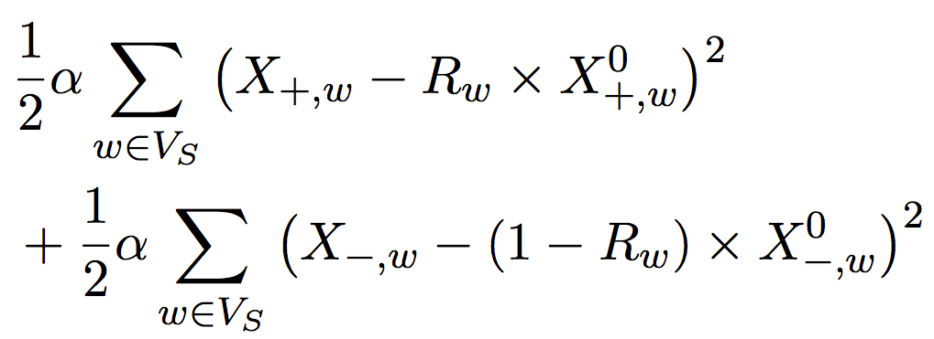
Exploiting knowledge via penalties
Penalty terms for two types of knowledge
Document-level knowledge
Domain-level knowledge
R_{W} : ratio of #tasks where w is positive / #all tasks

Slide 47
Use words not appeared in training
Interestingly, use words for classification in testing that have not appeared in training
P(w_{i} | c_{j})
w_{i} did not appear in the training data, but appears in the test data.
Traditional classifier cannot use it
But in lifelong learning, we can because
w_{i} may have appeared in the past learned knowledge.

Slide 48
One result

Slide 49
Backward transfer of knowledge (Wang et al. 2019)
Most existing lifelong learning methods
either only transfer knowledge forward to help future learning and do not go back to improve the model of a previous task
or
require the training data of the previous task to retrain its model to exploit backward/reverse knowledge transfer.
This paper studies reverse knowledge transfer of lifelong learning

Slide 50
By revising the generative model parameters
In this work, it is done by exploiting a key characteristic of the generative model of naive Bayes.
That is, it is possible to improve the naive Bayesian classifier for a task by improving its model parameters directly using the retained knowledge from other tasks.
Because
The generative model for each task is independent of other tasks
The model parameters are computed in building the model.
Thus no retraining is needed when going back to improve the model of any past task.

Slide 51
Using three types of knowledge

Slide 52
Results

Slide 53
DNN LL for sentiment classification (SC) (Lv, et al, 2019)
Now we use deep learning based LL to improve SC
Also called continual learning (with catastrophic forgetting)
Forgetting is not serious for sentiment classification.
LL helps sentiment classification due to shared knowledge.
However, there is still some forgetting
Note: this paper is not for solving the CL problem (too many existing methods).
This paper proposed SRK (Sentiment classification by leveraging the Retained Knowledge).
Tasks: document sentiment classification in multiple domains.

Slide 54
Exploiting the natural sharing of knowledge
In previous techniques, we need explicit knowledge base and explicit knowledge accumulated from the past.
Can we use deep learning directly and allow it to exploit the sharing information naturally and automatically by itself.
Yes, it works quite well.
We simply learn task by task without dealing with forgetting.
If we deal with forgetting, it is even better.
Our target is to improve the target domain.

Slide 55
Knowledge retention network
Goal: retain domain-specific knowledge from each task
Dealing with forgetting
Observation:
The network tends to remember only common knowledge across all tasks rather than important features in specific domains (except last).
Only a small number of neurons have high activation values. Most have relatively tiny activation values
Proposal:
Free neuron detection and gradient masking

Slide 56
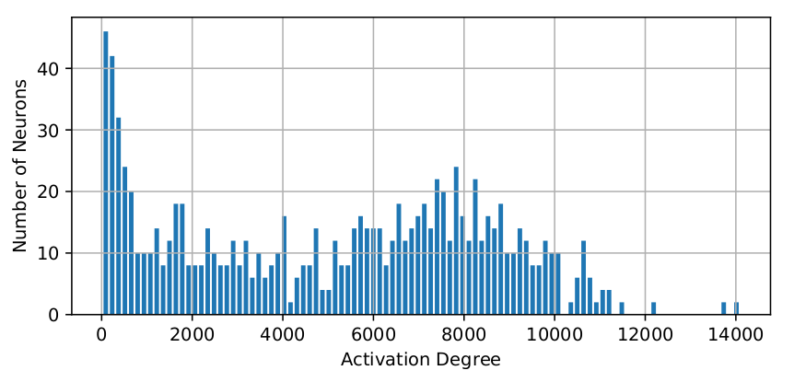
Activation Sparsity
Only a small number of hidden nodes have very high degrees of activation. Many have relatively tiny activation values.
This phenomenon becomes more obvious as the number of model parameters grows.
Use L1 regularization can make the activation more sparse.
Activation statistics in the state layer of GRU after convergence.
Higher activation degree means more chance to be activated in a task.
Notes:
This is little like the brain, while we should develop a method to process diff. tasks with diff. parameters.

Slide 57
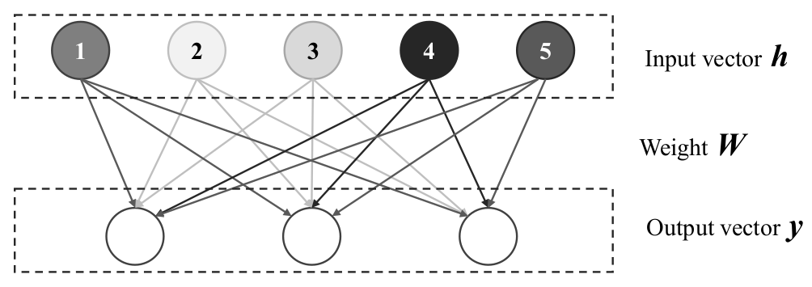
Knowledge Protection
Activation sparsity can be used for knowledge protection.
The output weights corresponding to the less activated neurons (2 and 3) are less important, and the frequently activated ones (1, 4, and 5) store much of the knowledge.
An example of a dense layer from a network.
Colors of the input neurons indicate the activation values. Darker color means a higher activation value or more activated.
Notes:
we can divide the partial update mechanism into two parts: Free Neuron Detection and Gradient Mask.

Slide 58
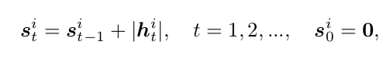
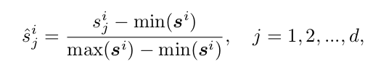
Free Neuron Detection
For each feed forward pass, keep a set of histogram information {s} for every layer’s input vector, values in {s} are updated as follow:
As the number of tasks grows, accumulation values {s} become larger and larger. To avoid overflow, we perform a linear normalization:
Sort values in the vector s in ascending order, the dimensions (neurons) whose values are in the top \epsilon % will be regarded as free neurons.

Slide 59
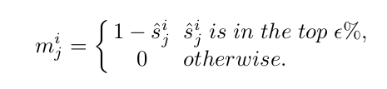
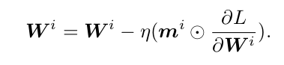
Gradient Mask
With the free neurons detected, when we are going to train the model on a new task, gradient masks will be used.
A gradient mask is a vector which has the same size as the layer’s corresponding input. The gradient mask can be computed as follows:
Apply the mask to the gradient, and then update the parameters.
Notes:
Here, I don’t want to involve some complex equations, for a presentation, it will be boring.
If you are interested in the very detail of the algorithm, you can read the paper, or contact me by email.
Then, I am going to show some performance of the model.

Slide 60
Components of SRK
Feature Learning Network (FLN): learn document representations to perform classification.
Knowledge Retention Network: Learn and retain domain specific knowledge from previous tasks.
Network Fusion Component: make the above networks work together to produce the final result.
Loss: Mean-Square Error (MSE), but doesn’t have to be

Slide 61
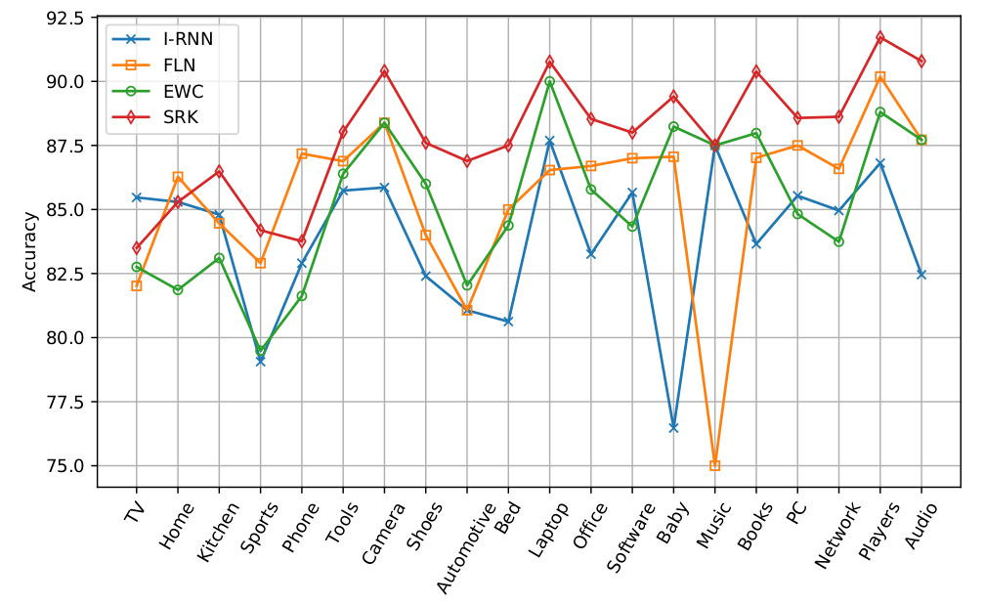
Experiment results

Slide 62
Experiment results
FLN: continual learning is better than isolated learning (I-RNN) consistently. Forgetting not handled.
LSC (Bayesian lifelong learning): better than I-RNN in general.
EWC: forgetting handling is not great for accuracy.
2-FLN: ensemble slightly helpful.
SRK improves new task learning significantly.
Avg. 86.68 83.86 87.73 88.44 86.29 89.85

Slide 63
Outline
A motivating example in sentiment analysis
What is lifelong learning?
Lifelong supervised learning
Semi-supervised never-ending learning
Lifelong topic modeling
Lifelong information extraction
Continual learning and catastrophic forgetting
knowledge learning in dialogues: Learning on the job
Open-world learning
Summary

Slide 64
Never Ending Language Learner (Carlson et al., 2010; Mitchell et al., 2015)
NELL: Never Ending Language Learner
Perhaps the only live LML system
it has been reading the Web to extract certain types of information (or knowledge)
24/7 since January 2010.
NELL has accumulated millions of facts with attached confidence weights
called beliefs,

Slide 65
Input to NELL
An ontology defining a set of target categories and relations to be learned,
a handful of seed training examples for each, and
a set of coupling constraints about categories and relations (Person & Sport are mutually exclusive).
Webpages crawled from the Web
Interactions with human trainers to correct some mistakes made by NELL

Slide 66
Goal of NELL
Reading - extract facts from the webpages to populate the initial ontology
category of a noun or noun phrase, e.g., Los Angeles is a city
relations of a pair of noun phrases
hasMajor(Stanford, Computer Science)
Learn to perform the above extraction tasks better each day.

Slide 67
Knowledge Base
Instance of category: which noun phrases refer to which specified semantic categories
For example, Los Angeles is in the category city.
Relationship of a pair of noun phrases, e.g., given a name of an organization and the location, check if
hasOfficesIn(organization, location).
…

Slide 68
NELL Knowledge Fragment

Slide 69
Semi-supervised Learning
Training examples
human-labeled instances in NELL’s ontology
labeled examples contributed over time through NELL’s crowdsourcing website,
a set of NELL self-labeled training examples corresponding to NELL’s current knowledge base,
a large amount of unlabeled Web text.
2nd and 3rd sets of the training examples propel NELL’s lifelong learning

Slide 70
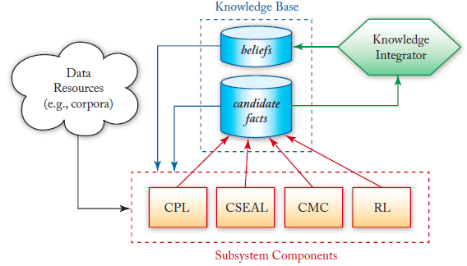
NELL Architecture

Slide 71
Coupled Pattern Learner (CPL):
CPL: extractors extracting both category and relation instances using contextual patterns.
Examples
Category pattern: “mayor of X” and
Relation pattern: “X plays for Y”
Such patterns can also be learned.
Mutual exclusion & type-checking constraints
filtered out candidate facts to ensure correctness

Slide 72
Coupled SEAL (CSEAL)
CSEAL: an extraction and learning system that extracts facts from semi-structured webpages using wrapper induction
Based on set expansion or PU learning
Wrapper: character strings specifying the left and right context of an entity.
Mutual exclusion & type-checking constraints:
filtered out likely errors

Slide 73
Coupled Morphological Classifier (CMC)
CMC: a set of binary classifiers, one for each category,
To classify whether the extracted candidate facts/beliefs by other subsystems are indeed of their respective categories.
Positive training examples:
beliefs in the current knowledge base.
Negative training examples
beliefs satisfying mutual exclusion constraints

Slide 74
Rule Learner (RL)
Its goal is to learn probabilistic Horn clauses
to use them to infer new relations from the existing relations in the knowledge base.
This reasoning capability
represents an important advance of NELL
It does not exist in most current LML systems.

Slide 75
Coupling Constraints in NELL
Multi-view co-training coupling constraint
Agreement: the same category or relation learned from different data sources, or views.
Subset/superset coupling constraint
When a new category is added to NELL’s ontology, its parents (supersets) are also specified.
Horn clause coupling constraint
E.g., “X living in Chicago” and “Chicago being a city in U.S.” → “X lives in U.S.”

Slide 76
Outline
A motivating example in sentiment analysis
What is lifelong learning?
Lifelong supervised learning
Semi-supervised never-ending learning
Lifelong topic modeling
Lifelong information extraction
Continual learning and catastrophic forgetting
knowledge learning in dialogues: Learning on the job
Open-world learning
Summary

Slide 77
Lifelong Topic Modeling (LTM) (Chen and Liu, 2014)
Aspect extraction: “the battery is great, but pictures are poor.”
Aspect terms: battery, picture
Aspect extraction actually has two tasks:
(1) extracting aspect terms
“picture,” “photo,” “battery,” “power”
(2) grouping synonymous aspect terms.
{“picture,” “photo”}, {“battery,” “power”}
Top modeling performs both tasks at the same time.
E.g., {price, cost, cheap, expensive, …}

Slide 78
What knowledge? (Chen and Liu, 2014, 2014)
Should be in the same topic
=> Must-Links
e.g., {picture, photo}
Should not be in the topic
=> Cannot-Links
e.g., {battery, picture}

Slide 79
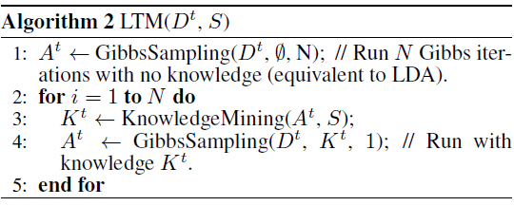
LTM: Lifelong Topic Modeling (Chen and Liu, 2014)

Slide 80
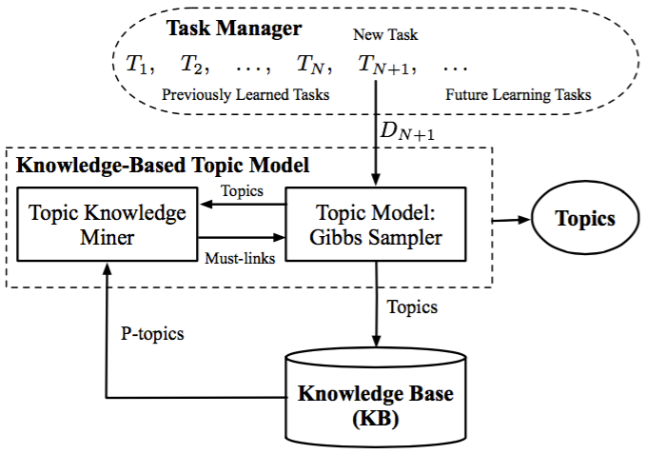
LTM architecture
Notes:
Must-links are mined dynamically.

Slide 81
An example of knowledge mining
Given a newly discovered topic:
{price, book, cost, seller, money}
We find 3 matching topics from topic base S
Domain 1: {price, color, cost, life, picture}
Domain 2: {cost, screen, price, expensive, voice}
Domain 3: {price, money, customer, expensive}
If we require words to appear in at least two domains, we get two must-links (knowledge):
{price, cost} and {price, expensive}.
Each set is likely to belong to the same aspect/topic.

Slide 82
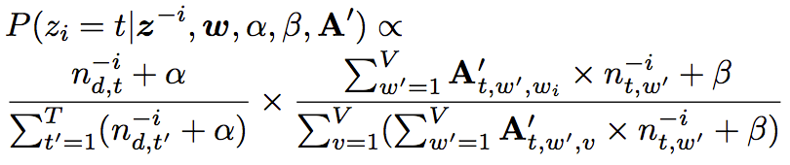
Model inference: Gibbs Sampling
How to use the must-links knowledge?
e.g., {price, cost} & {price, expensive}
How to know they are applicable?
Graphical model: same as LDA, but different inference
Generalized Pólya Urn Model (GPU)
Idea: When assigning a topic t to a word w, also assign a fraction of t to words in must-links sharing with w.

Slide 83

Simple Pólya Urn Model (SPU)

Slide 84
Simple Pólya Urn Model (SPU)

Slide 85
Simple Pólya Urn Model (SPU)

Slide 86
Simple Pólya Urn Model (SPU)

Slide 87
Simple Pólya Urn Model (SPU)

Slide 88
Simple Pólya Urn Model (SPU)
The rich get richer!

Slide 89
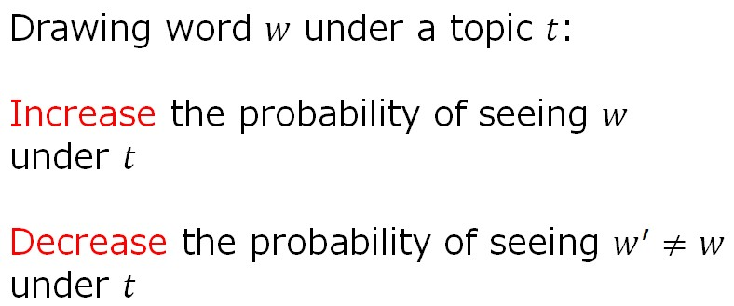
Interpreting LDA Under SPU

Slide 90
Interpreting LDA Under SPU
price
Topic 0

Slide 91
Interpreting LDA Under SPU
price
price
Topic 0

Slide 92
Generalized Pólya Urn Model (GPU)

Slide 93
Generalized Pólya Urn Model (GPU)

Slide 94
Generalized Pólya Urn Model (GPU)

Slide 95
Generalized Pólya Urn Model (GPU)

Slide 96
Applying GPU
price
Topic 0

Slide 97
Applying GPU
price
price
money
cost
Topic 0

Slide 98
Experiment Results

Slide 99
Outline
A motivating example in sentiment analysis
What is lifelong learning?
Lifelong supervised learning
Semi-supervised never-ending learning
Lifelong topic modeling
Lifelong information extraction
Continual learning and catastrophic forgetting
knowledge learning in dialogues: Learning on the job
Open-world learning
Summary

Slide 100
Lifelong Information Extraction
Specifically: aspect extraction
“The size is great, but pictures are poor.”
Aspects (product features): size, picture
An effective approach
Double Propagation (DP) (Qiu et al 2011): a syntactic rule-based methods
Still has a lot of room for major improvements.

Slide 101
Problem and Solution
Problem of syntactic rule-based methods
hard to design a set of rules to perform extraction with high precision and recall.
Possible solution
Use prior knowledge mined by exploiting the abundance of reviews for all kinds of products since many products share aspects.
e.g., many electronic products have aspect battery.

Slide 102
How to Use Prior Knowledge?
Use the information in reviews of a large number of other products to help extract aspects from reviews of the current product.
This idea is analogous to recommendation.
This work proposes to use DP as the base and improve its results dramatically through
aspect recommendation.

Slide 103
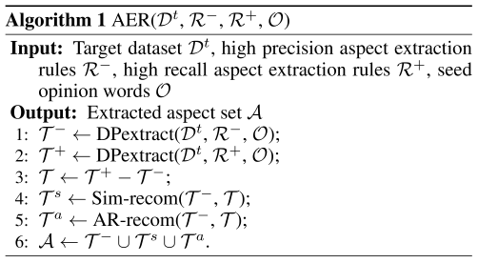
Overall Algorithm
Step 1: Base extraction
Step 2: Recommendation
Algorithm AER, short for Aspect Extraction based on Recommendation.

Slide 104
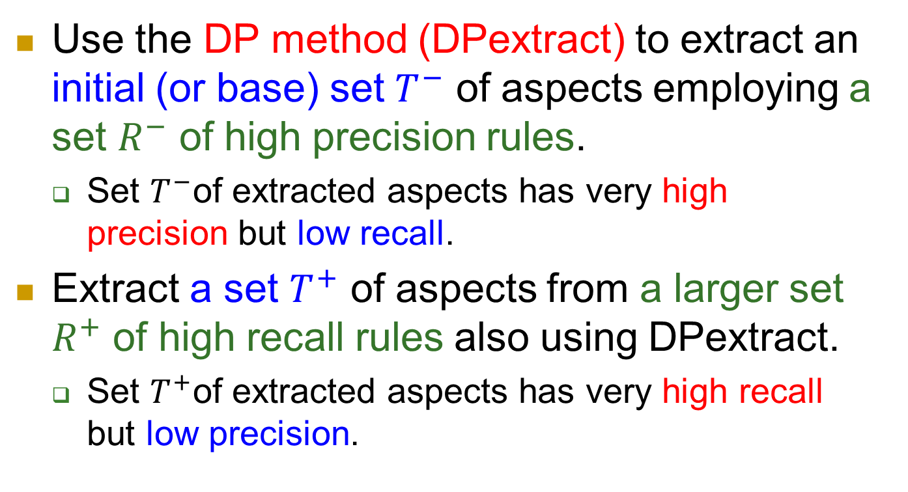
Step 1: Base Extraction
Use the DP method (DPextract) to extract an initial (or base) set $T^{−}$ of aspects employing a set $R^{−}$ of high precision rules.
Set $T^{−}$of extracted aspects has very high precision but low recall.
Extract a set $T^{+}$ of aspects from a larger set $R^{+}$ of high recall rules also using DPextract.
Set $T^{+}$of extracted aspects has very high recall but low precision.

Slide 105
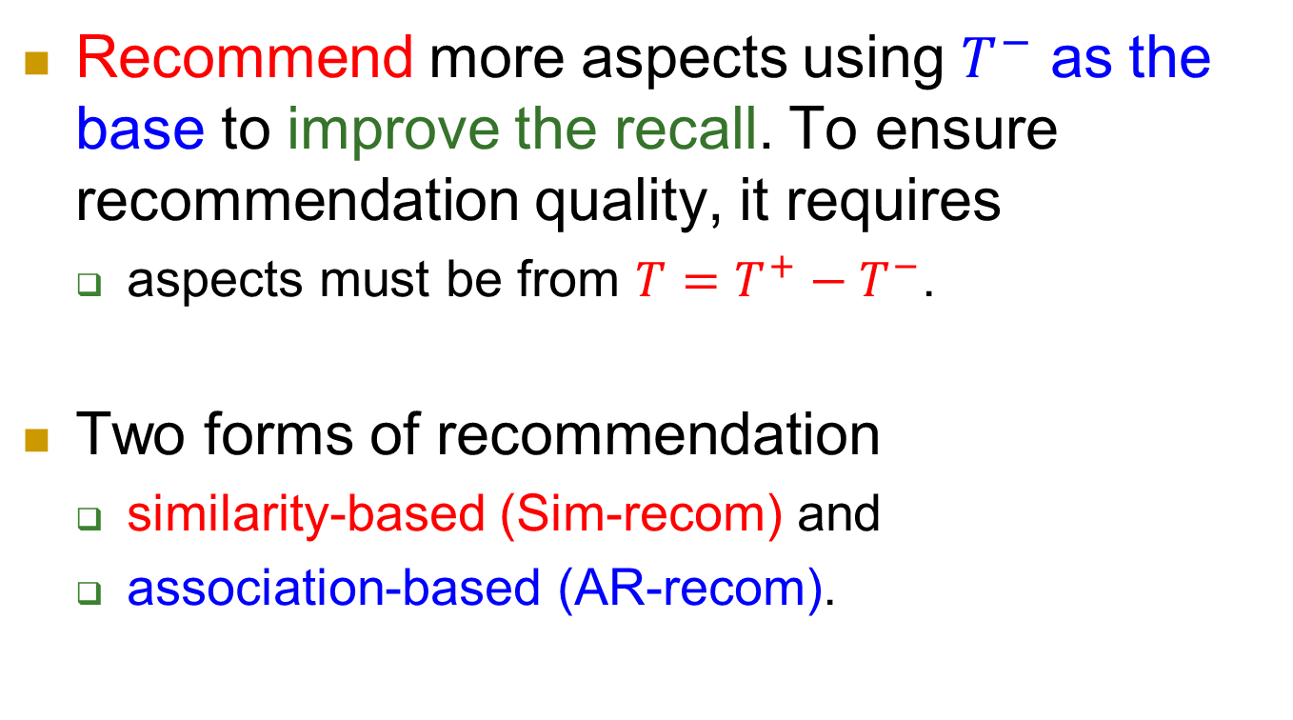
Step 2: Recommendation
Recommend more aspects using $T^{−}$ as the base to improve the recall. To ensure recommendation quality, it requires
aspects must be from $T=T^{+}−T^{−}$.
Two forms of recommendation
similarity-based (Sim-recom) and
association-based (AR-recom).

Slide 106
Similarity-based Recommendation
Solve the problem of missing synonymous aspects.
e.g., we can recommend “photo” and “image” through “picture” as they are similar in meaning.
Employ word vectors trained from a large corpus of 5.8 million reviews for similarity comparison.
But can also be trained using past data

Slide 107
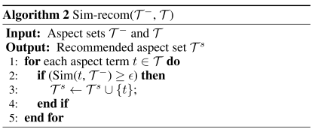
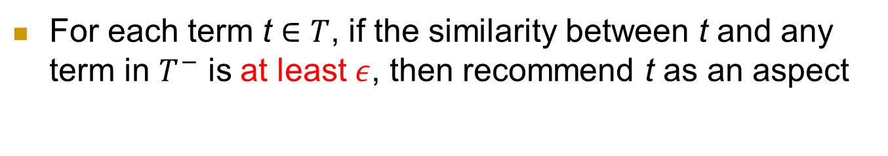
Algorithm Sim-recom
For each term t $∈T$, if the similarity between t and any term in $T^{−}$ is at least $ε$, then recommend t as an aspect

Slide 108
Association-based Recommendation
It aims to solve the problem of missing correlated or co-occurring aspects.
e.g., we can recommend “battery” through “picture” as they are highly related -- pictures are taken by digital devices which need batteries.
To mine aspect associations,
apply association rule mining to aspects extracted from reviews of previous products/domains.

Slide 109
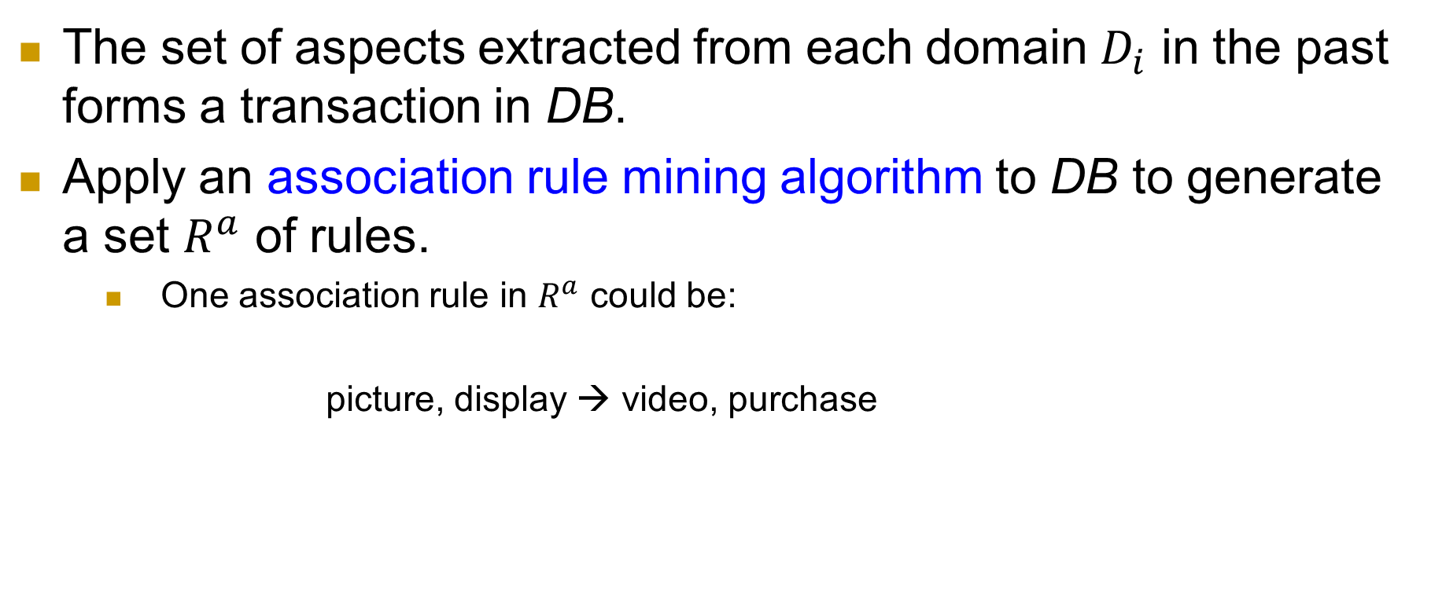
Association Rule Generation
The set of aspects extracted from each domain $D_{i}$ in the past forms a transaction in DB.
Apply an association rule mining algorithm to DB to generate a set $R^{a}$ of rules.
One association rule in $R^{a}$ could be:
picture, display → video, purchase
antecedent
consequent

Slide 110
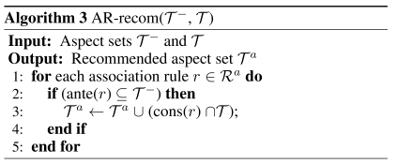
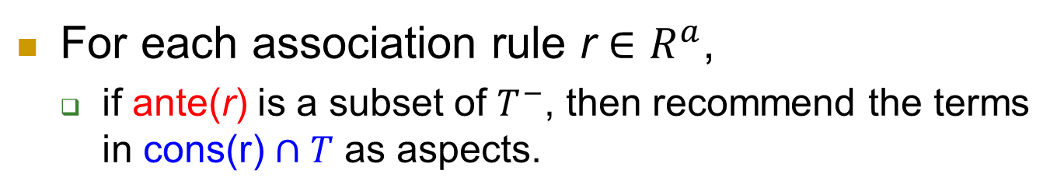
Algorithm AR-recom
For each association rule r $∈R^{a}$,
if ante(r) is a subset of $T^{−}$, then recommend the terms in cons(r) $∩T$ as aspects.

Slide 111
Compared Approaches
SimR uses only aspect similarities for recommendation.
ARR uses only aspect associations for recommendation.
AER uses both aspect similarities and associations for recommendation.

Slide 112
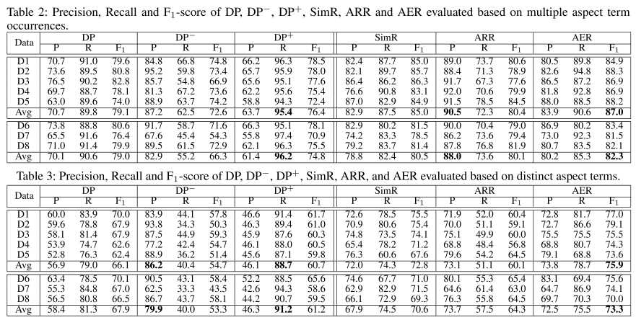
Experimental Results (Overall results)

Slide 113
Lifelong Relaxation Labeling (Shu et al 2016)
Relaxation Labeling (RL) is an unsupervised graph-based label propagation algorithm.
Unsupervised classification
It can be augmented with lifelong learning (Lifelong-RL) to exploit past knowledge learned from previous tasks.

Slide 114
Relaxation Labeling (RL)
Graph consists of nodes and edges.
Node: object to be labeled
Edge: a binary relationship between two nodes.
Each node n_{i} in the graph is associated with a multinomial distribution P(L(n_{i}))
L(n_{i}) is the label of n_{i} on a label set Y .
Each edge has two conditional distributions:
P(L(n_{i}) | L(n_{j})) and P(L(n_{j}) | L(n_{i}))

Slide 115
Relaxation Labeling (contd)
Neighbors Ne(n_{i}) of a node n_{i} are associated with a weight distribution w(n_{j} | n_{i})
RL iteratively updates the label distribution of each node until convergence.
Initially, we have P⁰(L(n_{i})). Let ΔP^{r+1}(L(n_{i})) be the change of P(L(n_{i})) at iteration r + 1.

Slide 116
Relaxation Labeling (contd)
Updated label distribution for iteration r + 1 is computed as follows:
The final label of node n_{i} is its highest probable label.
y))

Slide 117
What past knowledge can be used?
Lifelong-RL uses two forms of knowledge
Prior edges: graphs are usually not given or fixed but are built based on text data.
If the data is small, many edges may be missing
But such edges may existing in the graph of some previous tasks
Prior labels: initial P⁰(L(n_{i})) is quite hard to set, but results from previous tasks can be used to set it more accurately.

Slide 118
Lifelong-RL to a SA task (Shu et al., 2016)
Problem: opinion target labeling
Separating entities and aspects
Example: “Although the engine is slightly weak, this car is great.”
Entity: car; Aspect: engine
Target extract often cannot distinguish the two
Suitable for lifelong learning
Shared edges, and shared entities and aspects and their labels across domains
Notes:
In laptop, camera, cellphone domains, battery all belongs to an aspect.

Slide 119
Lifelong-RL architecture
Relation modifiers indicate edges.
Type modifiers and prior labels help set P⁰(L(n_{i}))

Slide 120
Outline
A motivating example in sentiment analysis
What is lifelong learning?
Lifelong supervised learning
Semi-supervised never-ending learning
Lifelong topic modeling
Lifelong information extraction
Continual learning and catastrophic forgetting
knowledge learning in dialogues: Learning on the job
Open-world learning
Summary

Slide 121
Continual learning and catastrophic forgetting
Continual learning (CL) mainly aims to solve the catastrophic forgetting problem in neural networks.
Catastrophic forgetting (CF): learning a new task will change the weights that have been learned for past tasks,
degrading the models for previous tasks.
like a human brain, ideally we want a network (like a brain) to learn many tasks with little interference (or little forgetting of the past).
Unlike lifelong learning, CL usually does not emphasize leveraging the past knowledge.

Slide 122
There are two settings
Class continual learning
each task consists of one or more classes to be learned together and the learning process builds a single model for classifying all classes. In testing, a test instance from any class may be presented to the model for it to classify.
Task continual learning
each task is a separate classification problem. One model is built for each task. All the models are in one neural network. In testing, the system knows which task each test instance belongs to and uses only the specific model for the task to classify the test instance.

Slide 123
Different approaches
Identifying network parameters that are important for previous tasks and try to keep them as much as possible.
Store some samples of the previous tasks and use them in the learning of the new task.
Produce data generators of previous tasks and use them to generate pseudo-data in place of sample data.

Slide 124
Continual learning via model adaptation (Hu et al., 2019)
This paper proposes Parameter Generation and Model Adaptation (PGMA) to deal with the problem.
The proposed approach learns to build a model, called the solver, with two sets of parameters.
The first set is shared by all tasks learned so far and
the second set is dynamically generated to adapt the solver to suit each test instance in order to classify it.

Slide 125
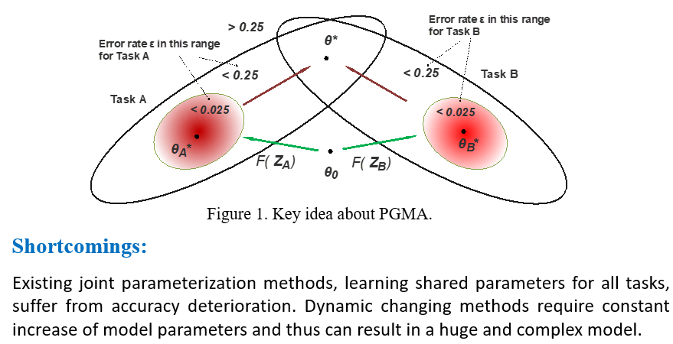
Main issue with previous approaches

Slide 126
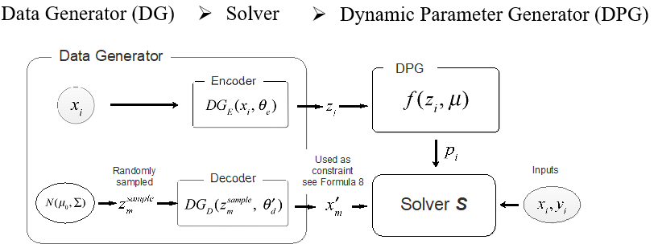
Overcoming CF via model adaptation
Learn a model (called Solver) with two sets of parameters.
The first set is shared by all tasks learned so far
The second set is dynamically generated to adapt the Solver to suit each test instance in order to classify it.

Slide 127
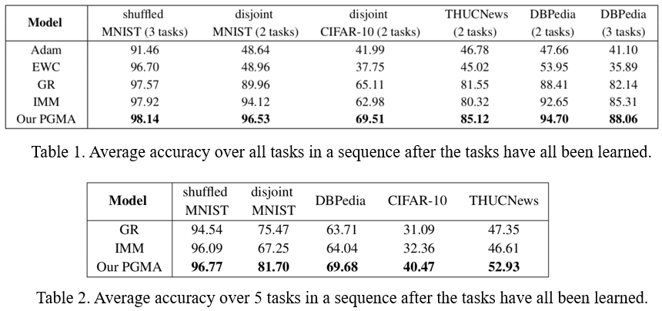
Experiment results

Slide 128
Outline
A motivating example in sentiment analysis
What is lifelong learning?
Lifelong supervised learning
Semi-supervised never-ending learning
Lifelong topic modeling
Lifelong information extraction
Continual learning and catastrophic forgetting
knowledge learning in dialogues: Learning on the job
Open-world learning
Summary

Slide 129
Continuous knowledge learning in dialogues (Mazumder et al. 2018, 2019)
Dialogue systems are increasingly using knowledge bases (KBs) storing real-world facts to help generate responses.
KBs are inherently incomplete and remain fixed during conversation,
it limits dialogue systems’ ability to answer questions and to handle questions involving entities or relations that are not in the KB.
We propose an engine for Continuous and Interactive Learning of Knowledge (CILK) for dialogue systems
to give them the ability to continuously and interactively learn and infer new knowledge during conversations

Slide 130
Some opportunities to learn in conversations
Extracting knowledge directly from user utterances. E.g.,
User: “Obama was born in Hawaii.”
(Obama, BornIn, Hawaii)
Asking user questions & expecting correct answers.
E.g., Agent: Where was Obama born?
User: Hawaii => (Obama, BornIn, Hawaii)
When agent cannot answer user questions, it asks the user for some supporting facts and then infers the answers.
We focus on this setting (1 and 2 are relatively easier).

Slide 131

Human conversation is knowledge driven? Why not for machines?
I watched ``The Dark Knight”
yesterday. It was awesome.
Grounding fact
USER1
Christian Bale Acted In
The Dark Knight
Did you like Christian
Bale’s acting?
USER2
Knowledge grounding makes conversation interesting and intelligent.

Slide 132
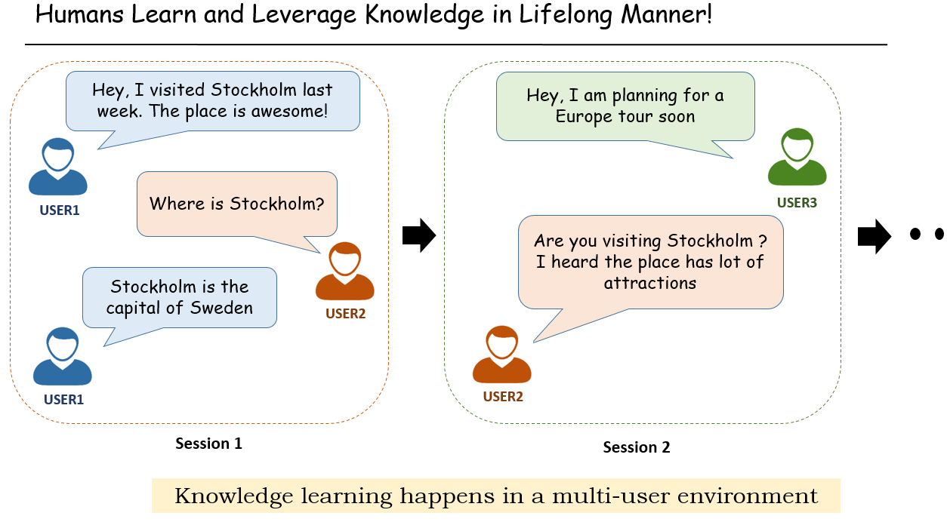
Knowledge learning in conversation

Slide 133
Focusing on building an engine
Learn factual knowledge that can be expressed as triples, knowledge graph.
(h, r, t): the entity h and the entity t can be linked by the relation r.
(Obama, CitizenOf, USA): Obama is a citizen of USA.
We only focus on developing a learning engine.
We do not study other functions like
dialogue generation, fact or relation extraction from user utterances, entity linking, etc., which have been studied extensively before and are assumed to be available for us to use

Slide 134
Open-world knowledge completion (Mazumder et al. 2018, 2019)
User asks a yes/no question that the system cannot answer
Is Obama a citizen of USA? [(Obama, CitizenOf?, USA)]
User asks a WH-question that the system cannot answer
In which country is Boston located? [(Boston, LocatedIn, ?)]
We model the engine as solving an open-world knowledge base completion (OKBC) problem
h, r, or e may not be in KB (open-world query)
Traditional closed-world knowledge base completion (KBC):
h, r, and e are all assumed to be in the KB (closed-world query).

Slide 135
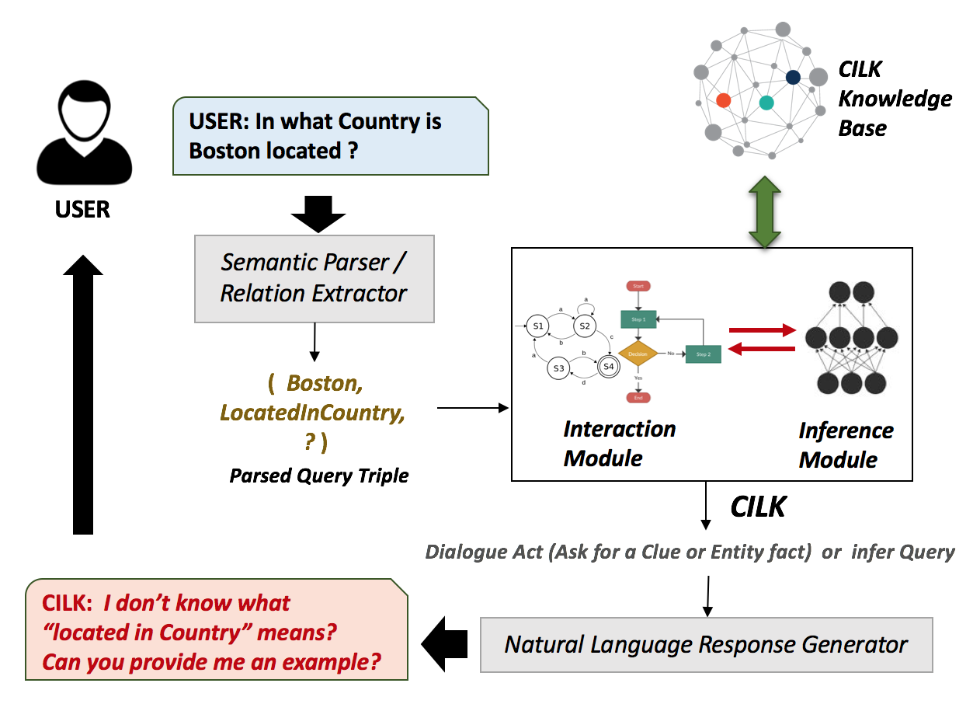
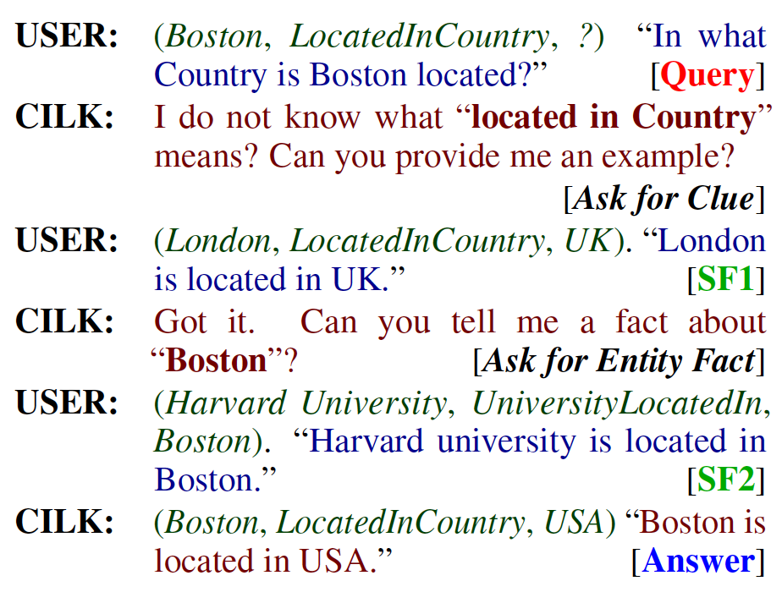
Interactive knowledge learning in dialogue: example (Mazumder et al. 2019)

Slide 136
Components of the system
Knowledge Base of triples
Interaction module:
decides whether to ask or not and formulates questions to ask the user for supporting facts
Updates KB with acquired knowledge used for training
Converts open-world queries to closed-world queries by asking the user questions related to
h (or t) and r to make them known to the KB (added to KB).
Inference module: using the acquired knowledge and KB to answer the resulting closed-world query: (h, r, t).

Slide 137
Problem formualtion
Given a user query / question (h, r, ?) [or (?, r, t)], our goal is two-fold:
Answering the user query or rejecting the query to remain unanswered if the correct answer is believed to not exist in the KB
learning / acquiring some knowledge (facts) from the user to help the answering task.
We further distinguish two types of queries:
(1) Closed-world Queries: h (or t) and r are known to the KB
(2) Open-world Queries: Either one or both h (or t) and r are unknown
Proposed Soln.
an engine for Continuous and Interactive Learning of Knowledge (CILK)

Slide 138
CILK: solution approach
Step 1 - Interact with the user: Convert open-world queries to closed-world queries by asking the user.
The user answers, called supporting facts (SFs), are the new knowledge to be added to KB.
Step 2 - Infer the query answer: Solve closed-world queries by inferring the query answer.
Use each entity e in the KB to form a candidate triple (h, r, e) (or (e, r, t)) which is then scored.
The entity e with the highest score is predicted as answer of the query

Slide 139
Outline
A motivating example in sentiment analysis
What is lifelong learning?
Lifelong supervised learning
Semi-supervised never-ending learning
Lifelong topic modeling
Lifelong information extraction
Continual learning and catastrophic forgetting
knowledge learning in dialogues: Learning on the job
Open-world learning
Summary

Slide 140
LL needs to identify unknowns (Fei et al, 2016; Shu et al., 2017)
If a system does not know what it knows & does not know, it
cannot function in a dynamic open world or learn new things by itself
E.g., self-driving cars
Traditional learning makes the closed world assumption:
Classes in testing have been seen in training, no new class in testing
Learning in the open world
Training data: 𝐷^{𝑡} = {𝐷₁, 𝐷₂, ... , 𝐷_{𝑡}} of classes 𝑌^{𝑡} = {𝑙₁, 𝑙₂, ..., 𝑙_{𝑡}}.
Test data: D_{t+1,} 𝑌^{𝑡+1} ∈ {𝑙₁, 𝑙₂, ..., 𝑙_{𝑡}, 𝑙₀}
Incrementally learn new classes

Slide 141
Extended definition of lifelong learning (Fei et al 2016, Shu et al 2017a, 2017, Chen & Liu, 2018, Mazumder, Liu, et al, 2019)
LL also works with a sequence of subtasks in a task, e.g., in dialogues.

Slide 142
Open classification: CBS learning
To detect unseen classes, Fei and Liu (2016) proposed CBS learning:
Center-based similarity (CBS) space learning.
It performs space transformation
Each document vector d is transformed to a CBS space vector
Compute centers c_{i} for the positive class
Compute the similarities of each document to c_{i}.
This gives us a new data set (in CSB space).

Slide 143
Space Transformation and Learning
We can use many similarity measures.
After space transformation, we can run SVM to build a classification in the CBS space
CBS learning basically finds a ball for each class

Slide 144
Traditional learning vs. CBS learning
Traditional learning (using SVM) CBS learning
Classification (testing)

Slide 145
DOC: Deep Open Classification of text documents (Shu et al. 2017)

Slide 146
Finding the rejection threshold

Slide 147
Learning incrementally (cumulatively)
Incrementally add a class without retraining from scratch
“Human learning”: uses the past knowledge F_{t} to help learn the new class l_{t+1}.
Find similar classes SC from known classes 𝑌^{𝑡}.
Old classes: 𝑌^{𝑡} = {movie, cat, politics, soccer}.
New class: l_{t+1}= basketball
SC = {soccer}
Building F_{t+1} by focusing on separating l_{t+1} and SC.

Slide 148
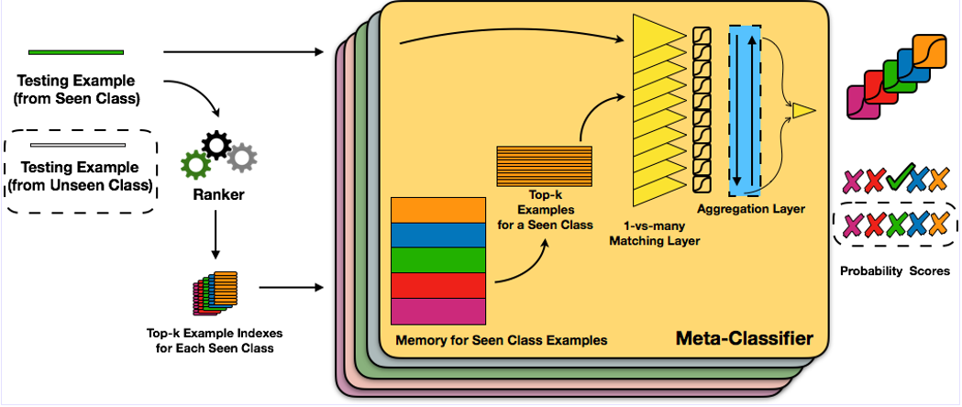
Open-world learning via meta-learning (Xu et al. 2019)
L2AC–meta-learning
It maintains a dynamic set S of seen classes that allows new classes to be added or deleted without re-training.
Each class is represented by a small set of training examples.
In testing, the meta-classifier uses only the examples of the seen classes on-the-fly for classification and rejection

Slide 149
Experimental results

Slide 150
Improving model in testing or execution (Shu et al 2017)
Can a model’s performance be improved after training?
This paper proposes a technique to do this in the context of CRF for information extraction.
Idea: connect features with extraction results
More results → better features
It exploits dependency features
As the model sees more data, more features are identified
These features help produce better results in the new domain using the same model.

Slide 151
Extended definition of lifelong learning (Fei et al 2016, Shu et al 2017a, 2017, Chen & Liu, 2018, Mazumder, Liu, et al, 2019)
LL also works with a sequence of subtasks in a task, e.g., in dialogues.

Slide 152
Outline
A motivating example in sentiment analysis
What is lifelong learning?
Lifelong supervised learning
Semi-supervised never-ending learning
Lifelong topic modeling
Lifelong information extraction
Continual learning and catastrophic forgetting
knowledge learning in dialogues: Learning on the job
Open-world learning
Summary

Slide 153
Summary
Lifelong and continual learning is necessary for intelligence.
Isolated single task learning is insufficient.
LL is still in its infancy with huge challenges (Chen & Liu, 2018):
Correctness and applicability of knowledge, self-supervision and interaction, knowledge representation & reasoning, composition, etc.
Going beyond
Is the current DNN suitable for lifelong and continual learning?
What is the cognitive model for learning and self-supervision?
Exciting time: lots of opportunities and challenges

Slide 154

Thank You
Q&A
https://www.cs.uic.edu/~liub/2018-LML-2nd-edition.pdf

